Slide 1
Angular JS form Validation
Unit-5

Slide 2
Form Validation
AngularJS offers client-side form validation.
AngularJS monitors the state of the form and input fields (input, textarea, select), and lets you notify the user about the current state.
AngularJS also holds information about whether they have been touched, or modified, or not.
You can use standard HTML5 attributes to validate input, or you can make your own validation functions.

Slide 3
Angular JS Validation
CSS classes for form validation.
Putting Validation control states

Slide 4
Angular JS Classes
To allow styling of form as well as controls, ngmodel adds these CSS classes:
Ng-valid
Ng-invalid
Ng-pristine
Ng-dirty
Ng-touched
Ng-untouched

Slide 5
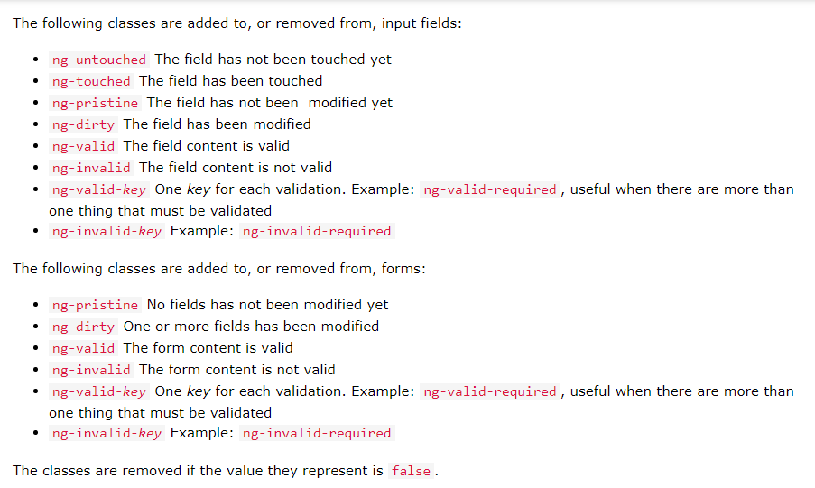

Slide 6
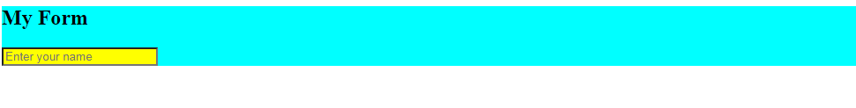
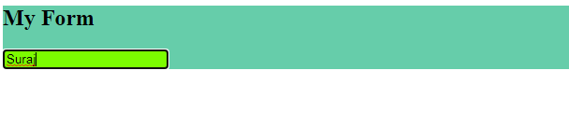
Example of Angular JS CSS form validation
CSS Validation Effect

Slide 7
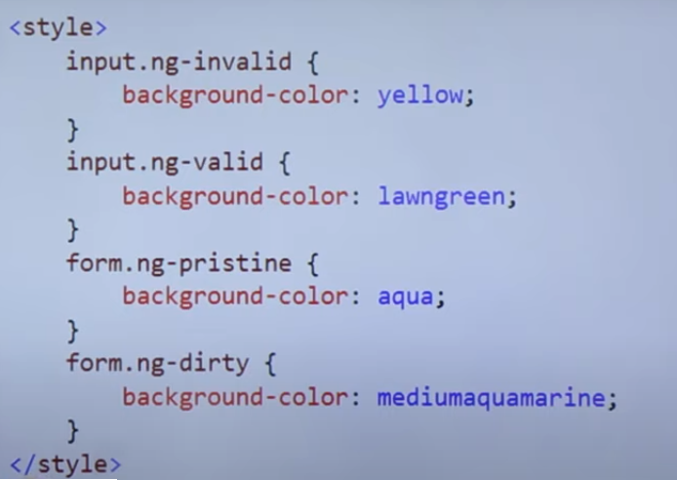
Angular JS CSS classes
Note: Run the program shown in Class

Slide 8
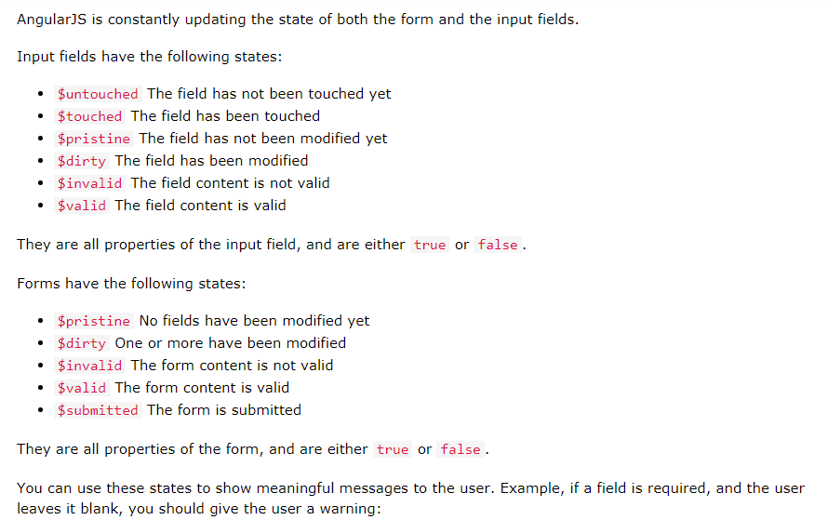
Putting validation control states

Slide 9
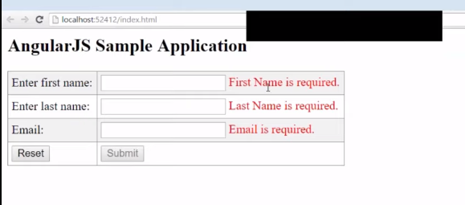
Demonstration of Form validation
For answer and source code refer class room program and notes.

